Slide 1


Mobile and Wireless Networking Group Lab
Dr. Eyuphan Bulut
Notes:
fi

Slide 2
Research Interests

Slide 3
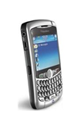

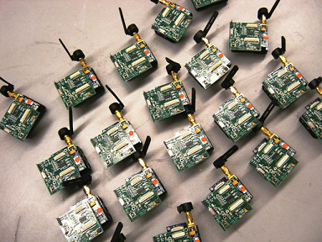
Research Interests
Mobile to Mobile
Interactions
Mobile Sensing and Computing
Mobile (Cellular) Packet Core
Mobile Security

Slide 4
Research Interests
Domains
Ad hoc and sensor networks (DTNs)
Mobile social networks (smartphones-humans)
Cellular networks
Problems
Efficient Routing Algorithms
Understanding Mobility, pairwise relations
Privacy, Trust Management
Crowd-Sourcing
Cellular Network Offloading
Opportunistic Wireless Energy Transfer

Slide 5
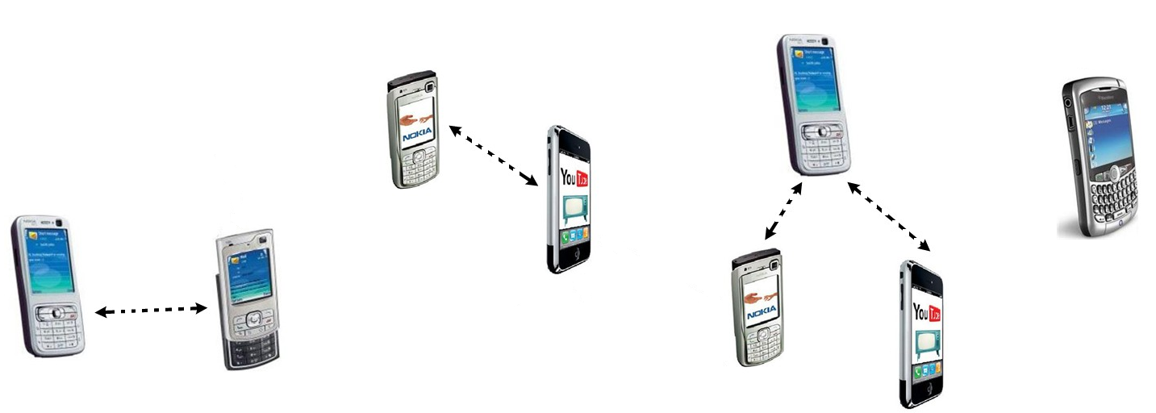
Efficient Routing Algorithms
Opportunistic, sparse, delay-tolerant
Disaster, infrastructure-less scenarios
Social/Friendship Relations
Forward/Copy
Message?
Full or partial message?
Meeting (contact)
duration
Correlated Node
Mobility
Inter-meeting

Slide 6
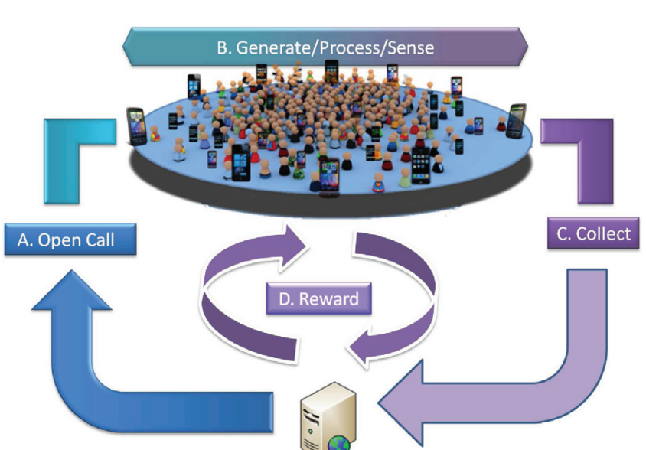
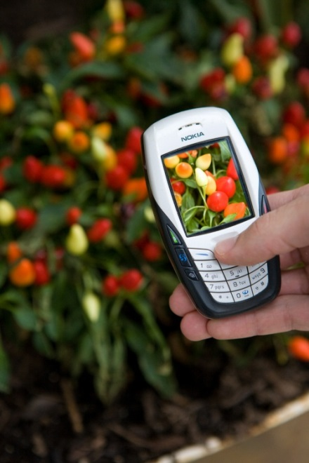
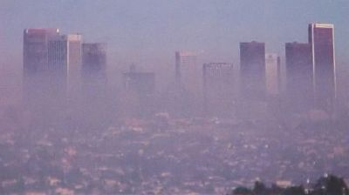
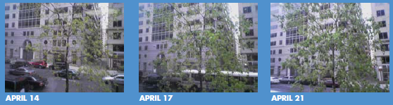
Mobile Sensing and Computing
Crowd-Sourcing
Optimization of data collection process
Filtering of data (camera orientation etc.)
Incentive mechanisms
Apps utilizing smartphone sensors
http://www.cs.ucy.ac.cy/~dzeina/papers/ic12-crowdsourcing.pdf

Slide 7

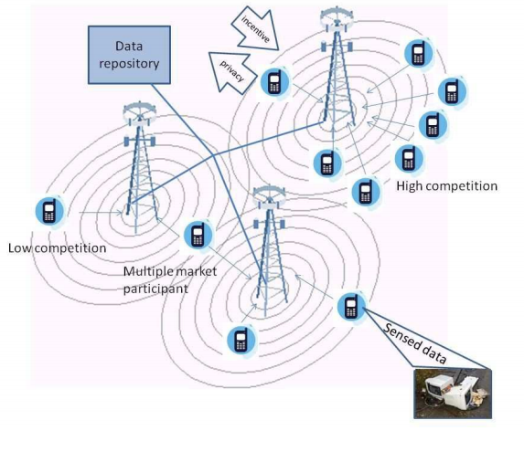
Participatory or Crowd Sensing
$
Promoting participation
Dynamic pricing
Social concerns:
Privacy preservation
Power consideration
Challenges:
Recruitment
Incentive mechanism
Feature extraction
Anonymizing data
Reverse Auction
$$$
$$$
$$
Notes:
-If the power of a participant’s device is decreasing, then the participant should have a higher bid (what auctioneer sees) since power is more scarce for them.
-If a device belonging to a participant is sensing frequently, the participant should be awarded higher incentive. This recognizes loss of privacy associated with sending data with
location of device to the sink.

Slide 8
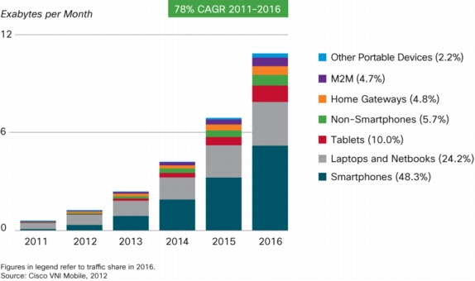
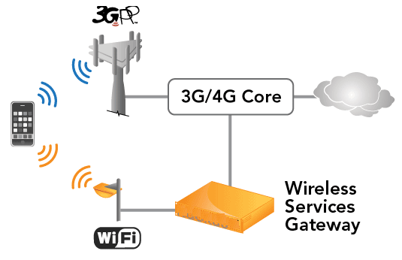
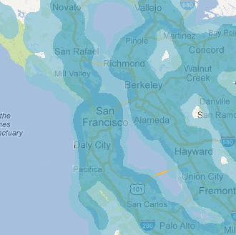
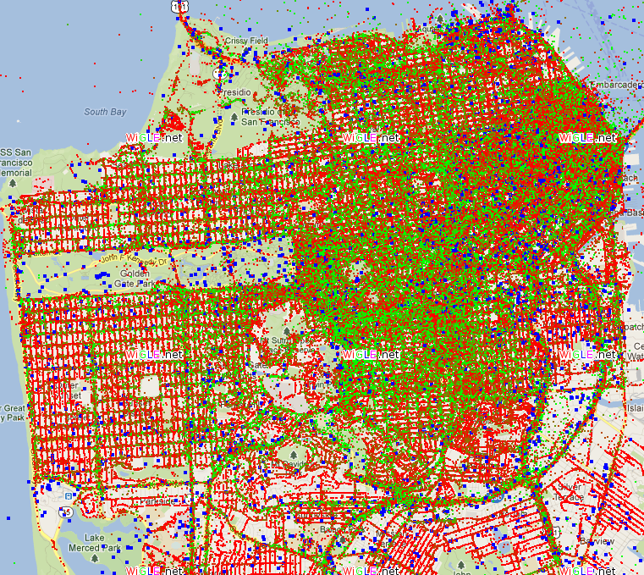
Mobile (3G/4G) Systems
18X growth
How to offload?
Deploying new WiFi APs
Recruiting third-party APs
red= encrypted, green = free
[Skyhook]
[Wigle.net]

Slide 9
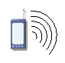

Enhancing Offloading via MSNs
Delay tolerant traffic can be offloaded via WiFi APs
MSN routing could extend AP ranges
Server
User
Cellular connection
Cellular Network Core
Wired connection
Connectivity occurs by time
Data
MSN
routing
Connectivity occurs by time
WiFi AP
Wired connection
Data downloaded

Slide 10
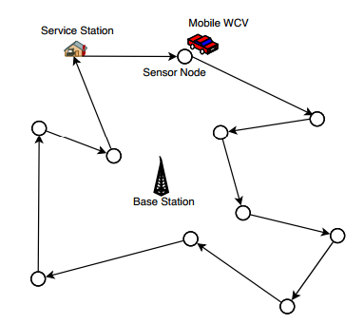
Wireless Power Transfer
Recent breakthroughs
90% efficiency in 2m
UAV energy transfer
Collaborative mobile charging
Stable
Sensor node
Mobile charger

Slide 11
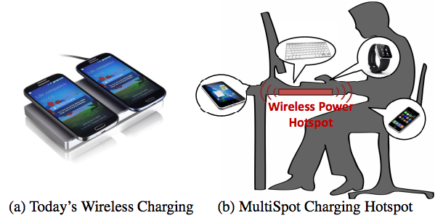
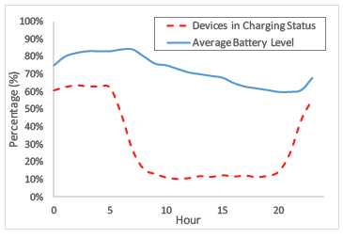
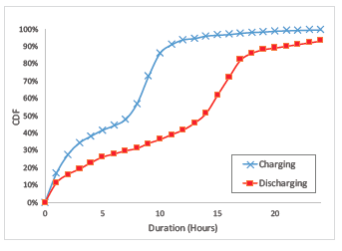
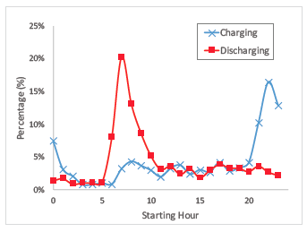
Opportunistic D2D Energy Sharing
Understanding charging
characteristics
Modeling Market? Buy/Sell
Who will share who to
maximize saving?
http://www.sigmobile.org/mobicom/2015/papers/p2-shiA.pdf

Slide 12
Mobile Security
Last items of puzzle
Computing
Offloading
Routing
Privacy
Sensing
Security
Trust
Energy Transfer
Sensing

